Slide 1

What’s new in F12 for Project Spartan
Microsoft Edge
Andy Sterland
@AndySterland | Andy.Sterland@microsoft.com
Senior Program Manager, Visual Studio, Web Diagnostics

Slide 2

F12

Slide 3
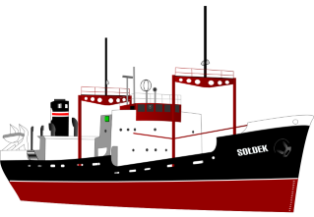
F12 Focus for Win10
Use Microsoft Edge to finish turning F12 around and get her going in the right direction

Slide 4


The Road Ahead
Tools for IE11 on Win10+ are frozen
Full steam ahead for Project Spartan

Slide 5



Browser Tools – A lot in common
DOM Inspection
Style Tracing
Computed Properties
Layout View
Color Picker
Debugger
Breakpoints
Watches
Console
Console API
CPU profiling
Style profiling
Network tracing
Heap snapshots
Snapshot diffing
Auto completion
Inspect element
Pretty printing
The 80% Case
So, so many tools in the tool box
*Not to scale or remotely mathematically sound!

Slide 6
Browser Tools – A little unique
Network throttling
Device emulation
Pseudo elements
Edit and continue
Paint correlation
CSS animation
Animation scrubbing
More…
3D view
Web audio editor
Animation
Shader editor
Reflow event logging
Responsive design mode
Lots of extensions
More…
TracePoints
Statement level JS
Just my code
Find references
Set next statement
Track changes
TypeScript colouring
More…

Slide 7


Slide 8
More than F12

Slide 9
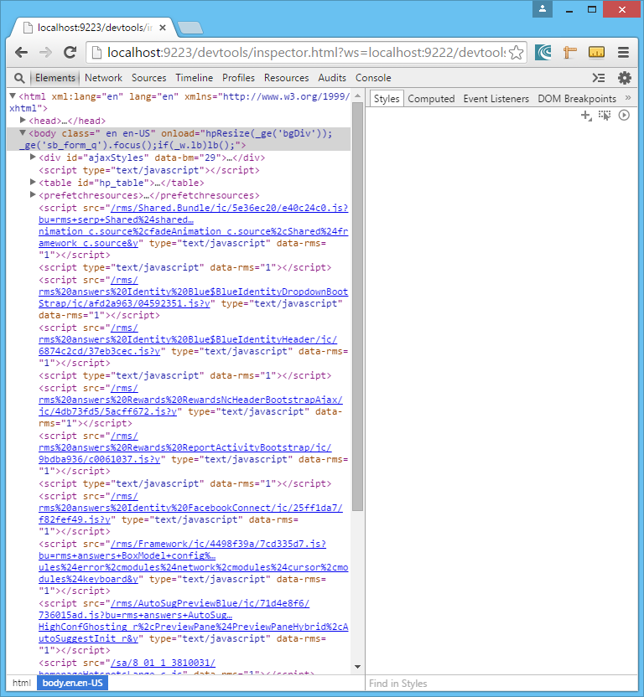
Playing better with others
exposing the chrome remote debug protocol

Slide 10
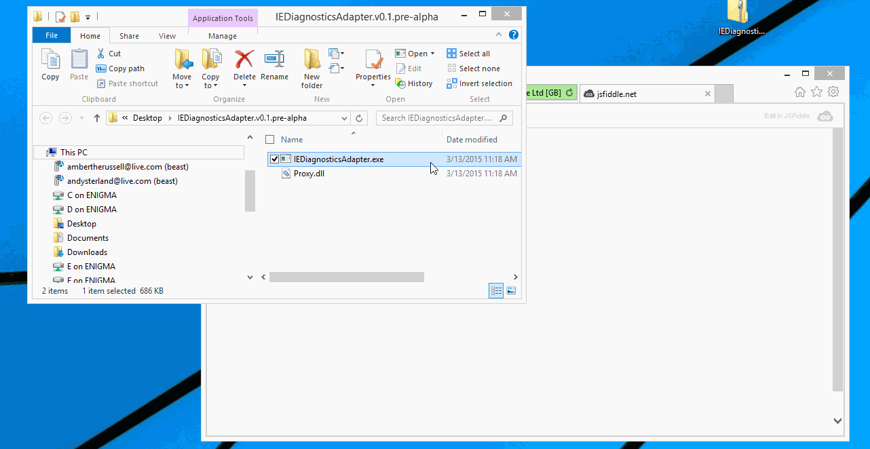
Diagnostics adapter enabling Chrome tools to attach to IE11
(just debugging for now - https://github.com/Microsoft/IEDiagnosticsAdapter/)

Slide 11
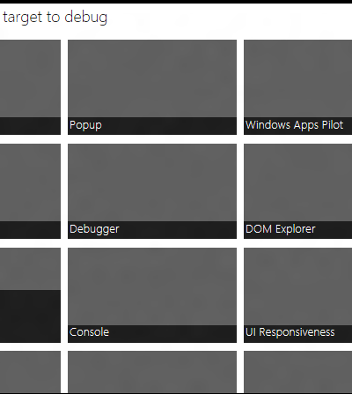
F12 against IE anywhere (locally..)
C:\Windows\System32\F12\F12Chooser.exe

Slide 12
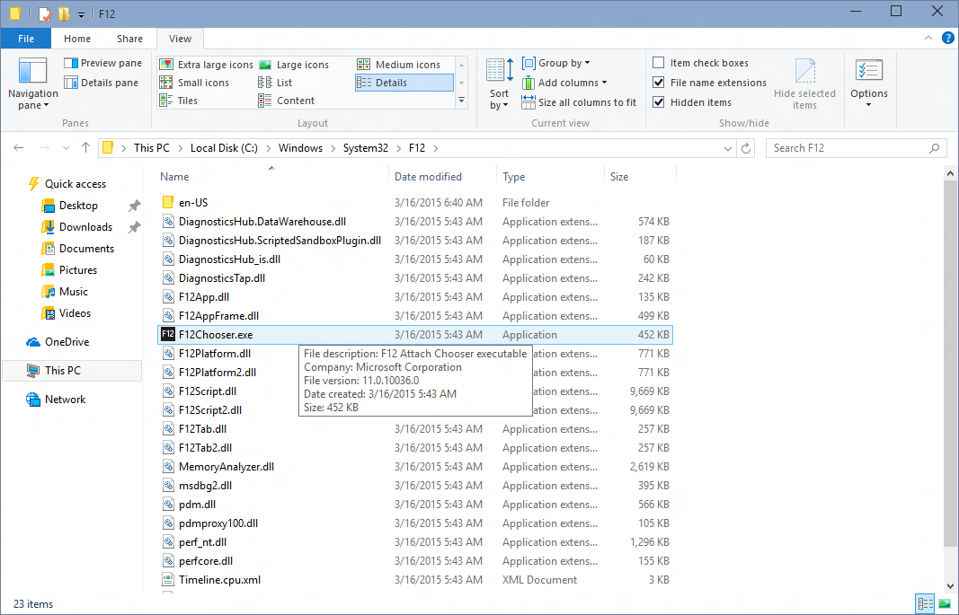
Located at: C:\Windows\System32\F12\F12Chooser.exe

Slide 13
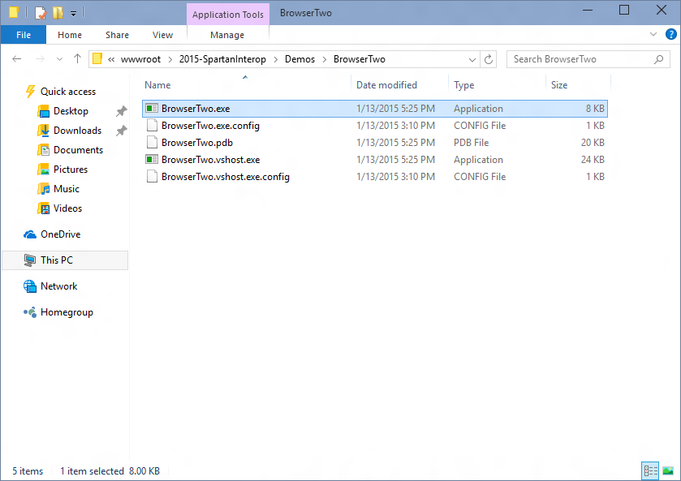
Launch the app you want to debug (winforms, win32, wpf)

Slide 14
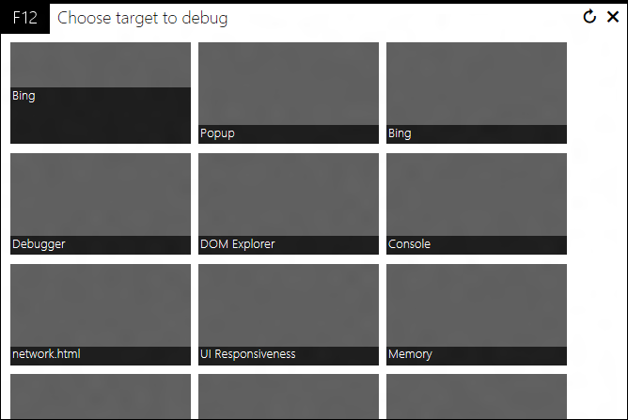
You’ll get something like this with a tile for each app you can debug

Slide 15
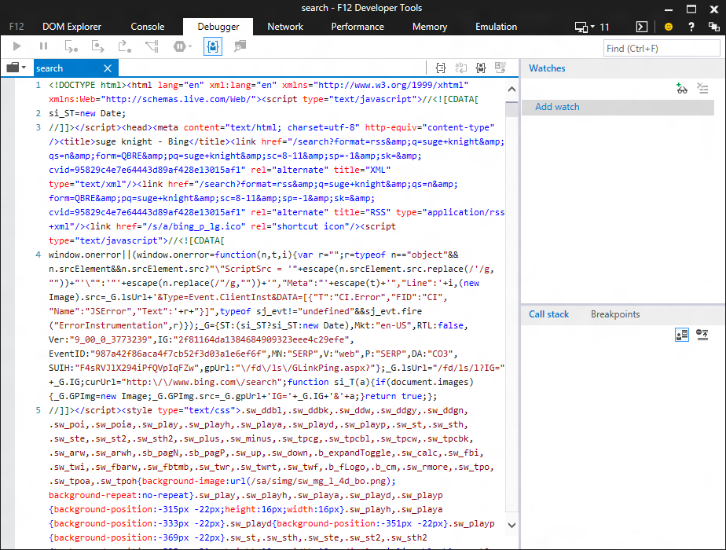
Launches F12 against the app…

Slide 16
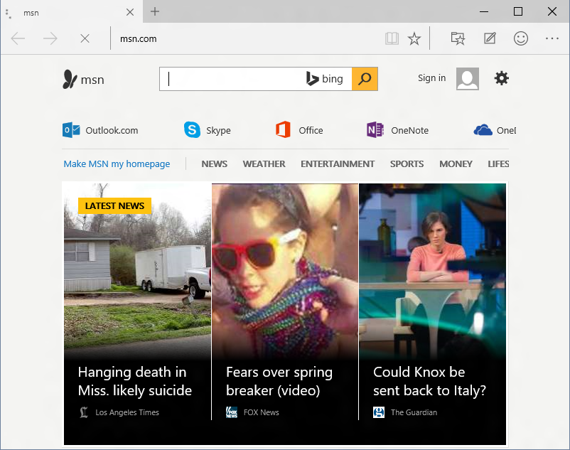
Works for Project Spartan too! (It’s going to be your best bet for the //build flight)

Slide 17
F12 Chooser also works against apps that multiple web instances

Slide 18
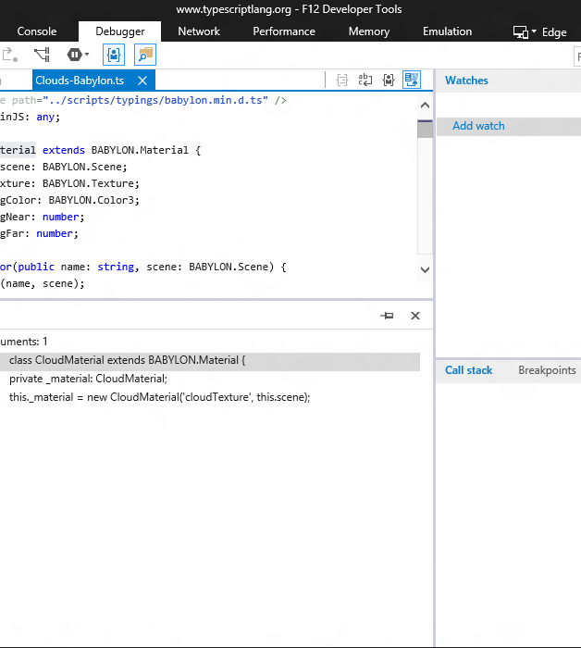
Making hard things easier
async debugging
better source navigation
sourcemaps for css
pretty print anything

Slide 19
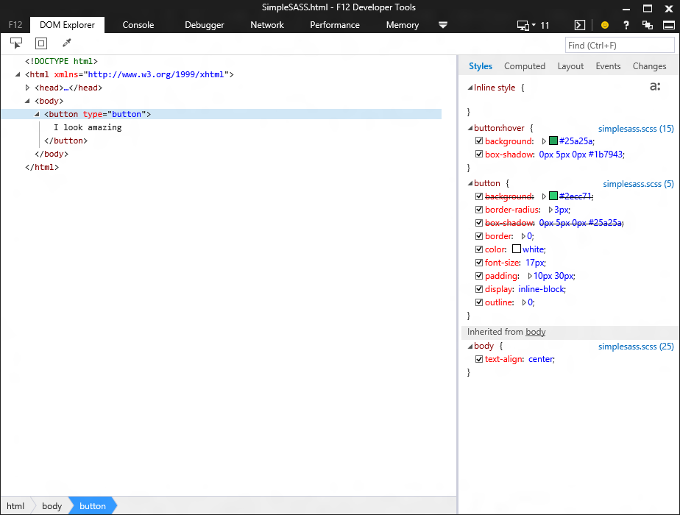
Source mapped style links in the DOM Explorer

Slide 20
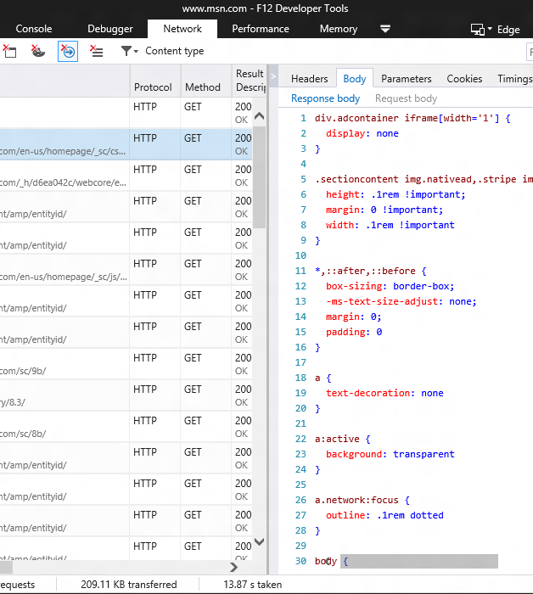
New network tool

Slide 21
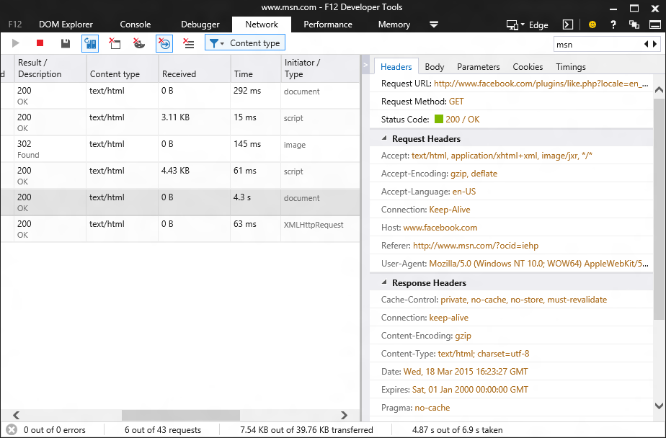
Brand new tool (built in HTML & JS)

Slide 22
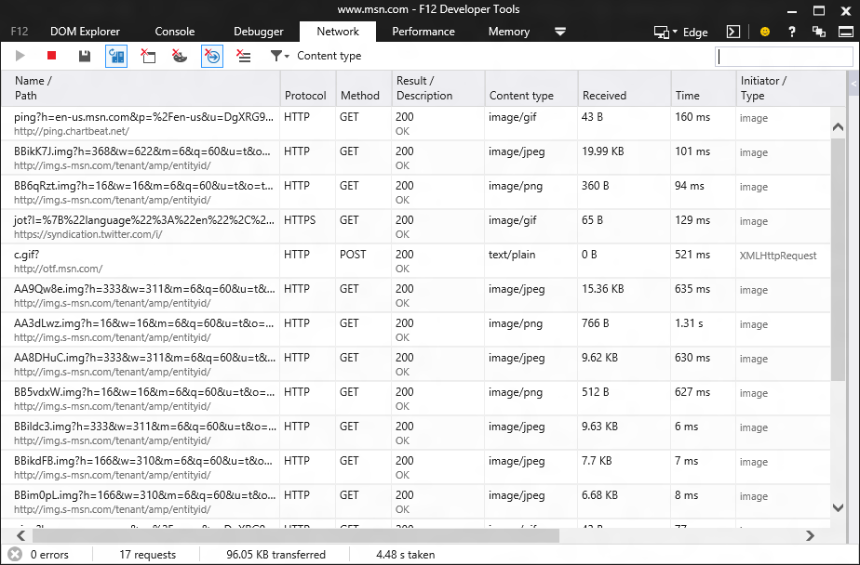
Recording start by default

Slide 23
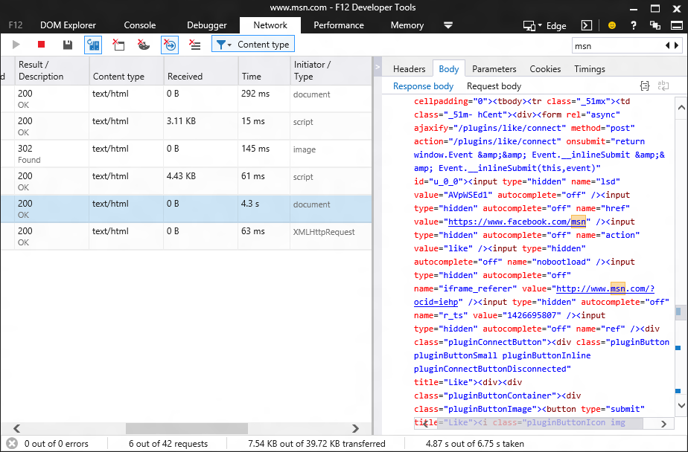
Search all network data

Slide 24
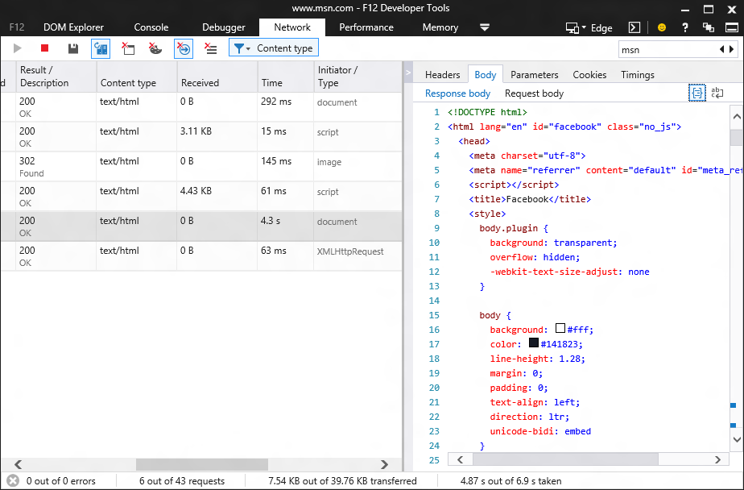
Pretty printing for common file types (including JSON!)

Slide 25
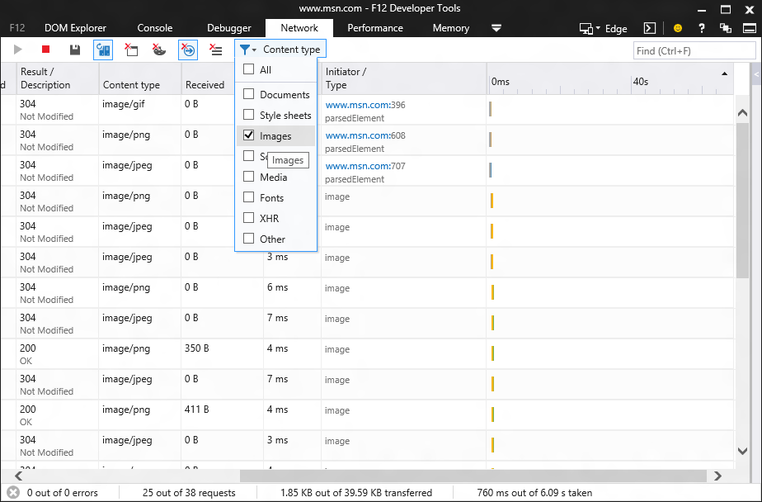
New: Type filtering

Slide 26
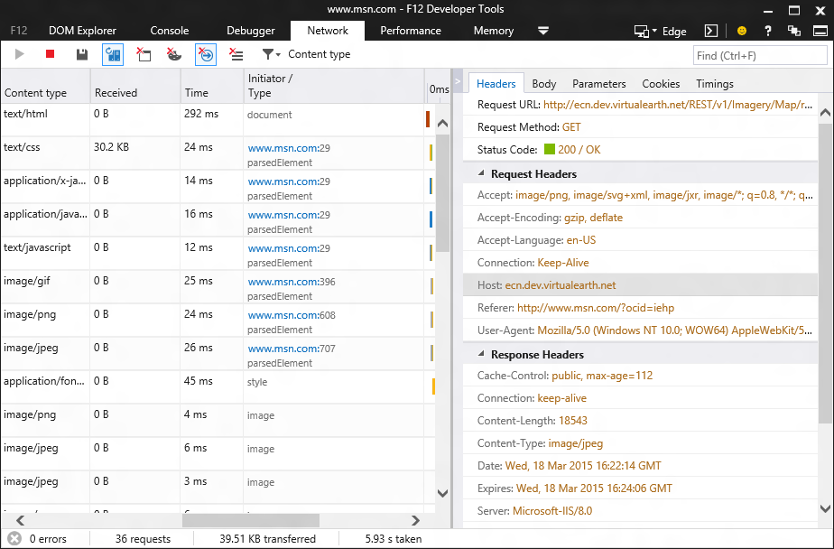
Download initiator

Slide 27
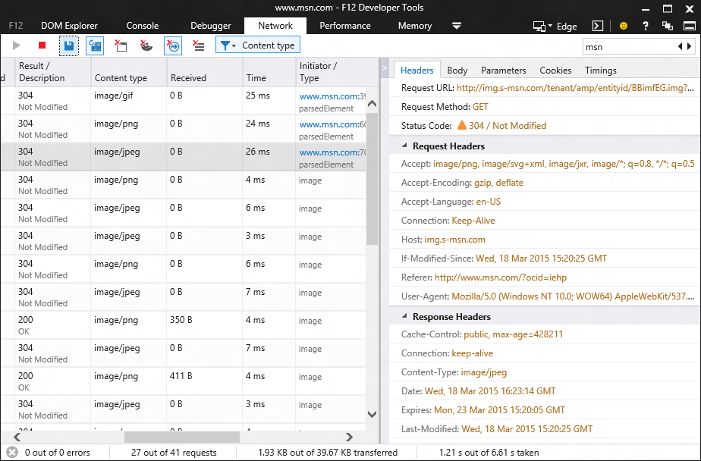
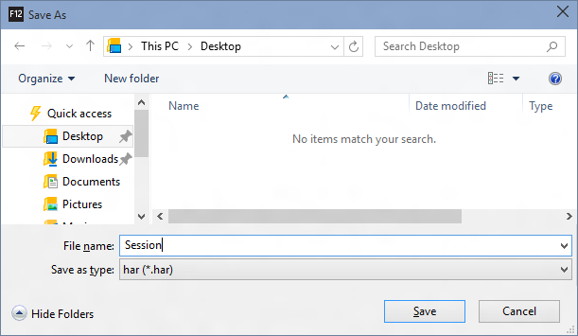
Export to HAR

Slide 28
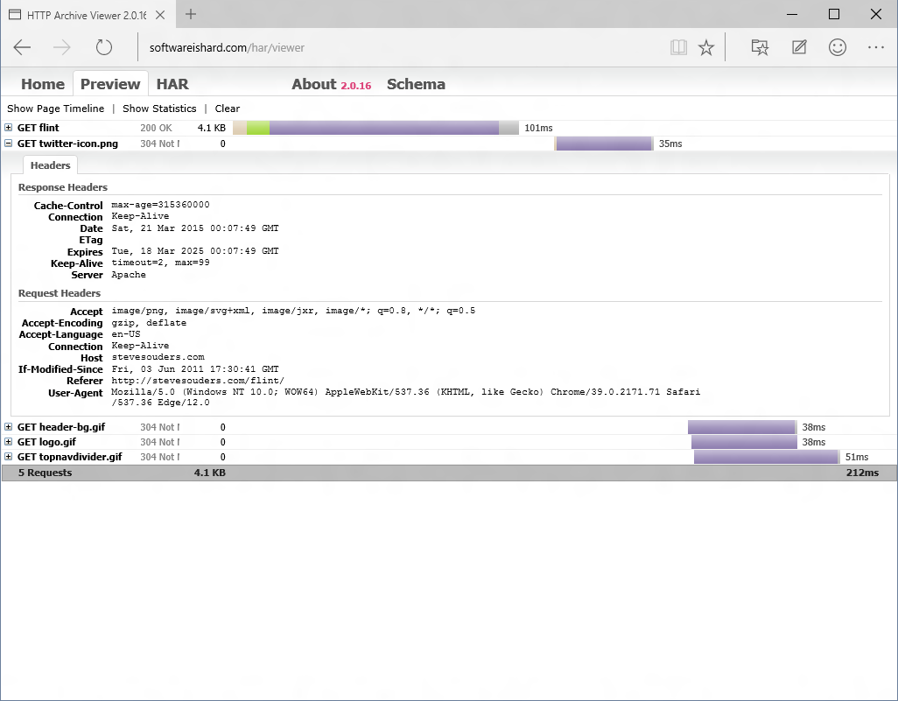

Slide 29
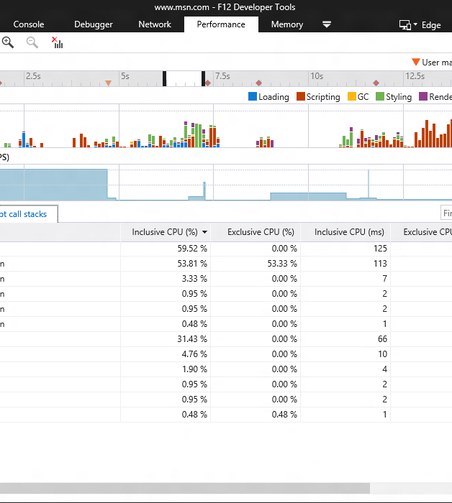
Updated performance tool (nee UI responsiveness tool)
new name
user marks
new cpu profiler

Slide 30
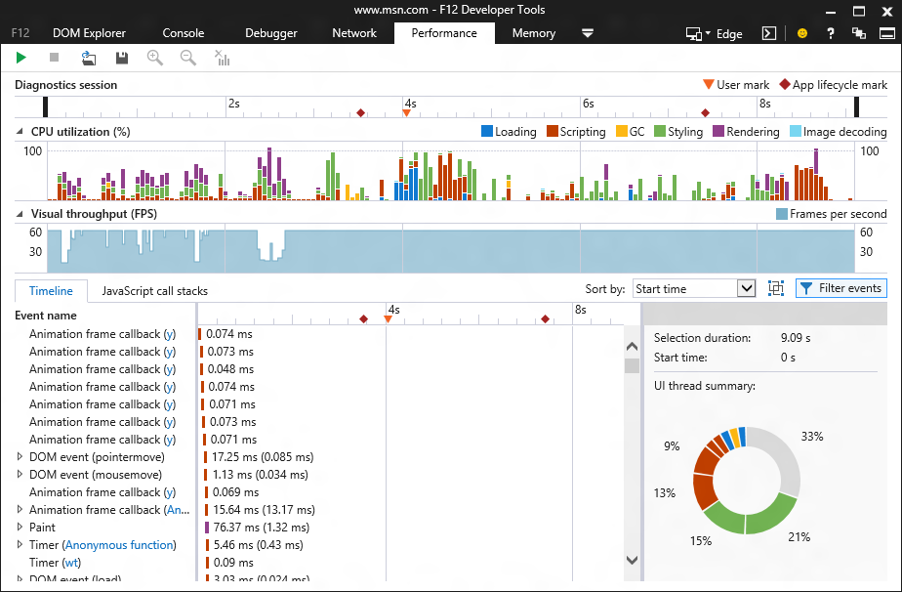
UI responsiveness tool is now named “Performance”

Slide 31
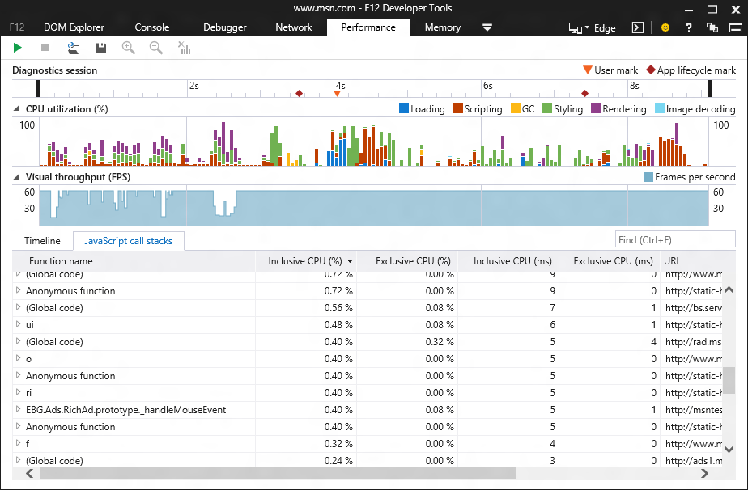
JavaScript profiler now integrated into performance tool (sampled so way less overhead than the old profiler)

Slide 32
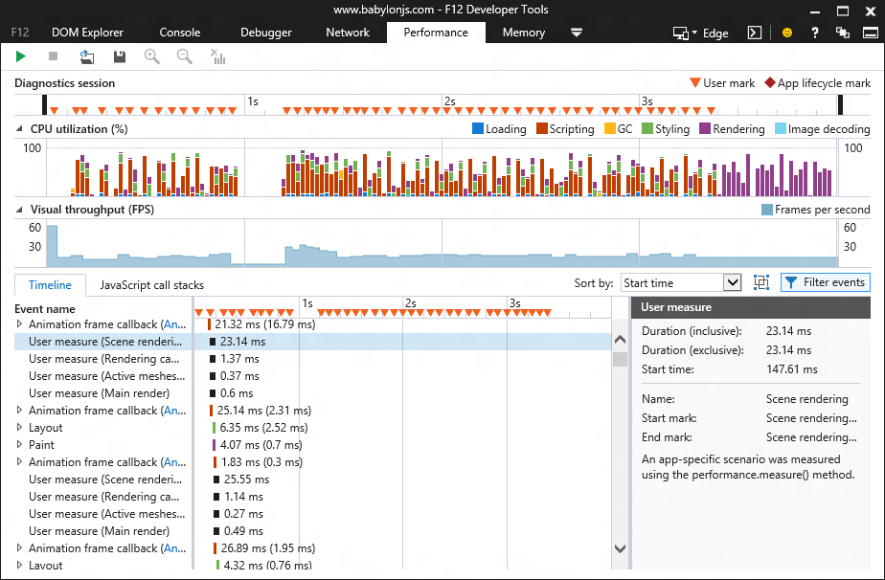
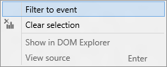
User marks help you tailor the profiler view ()

Slide 33

Adding experimental features
javascript editing
css editing
cookie inspection
local and session storage

Slide 34
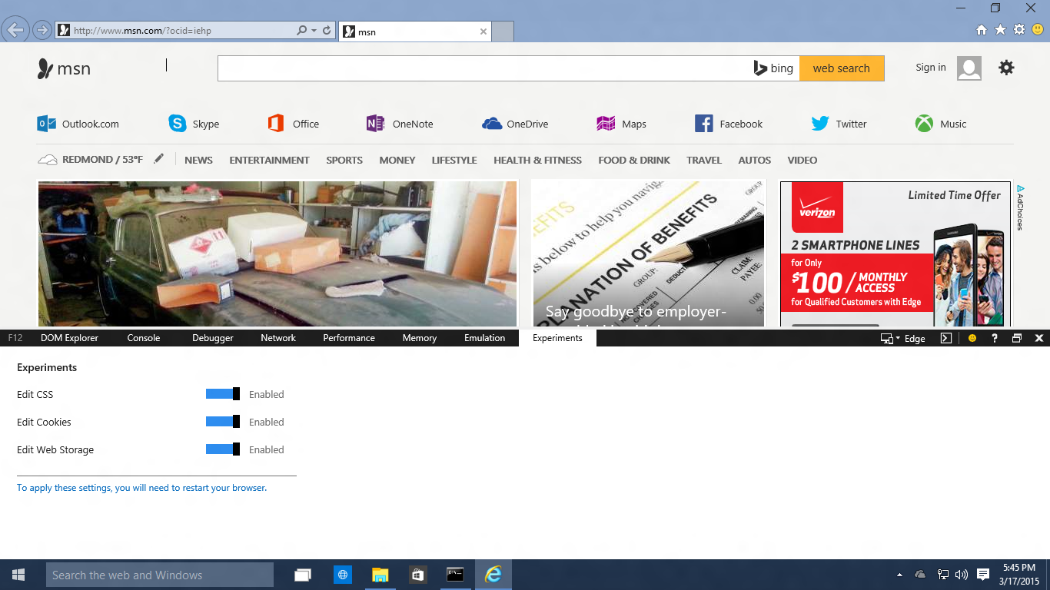
It’ll look something like this…

Slide 35
Coming up next…

Slide 36


Slide 37
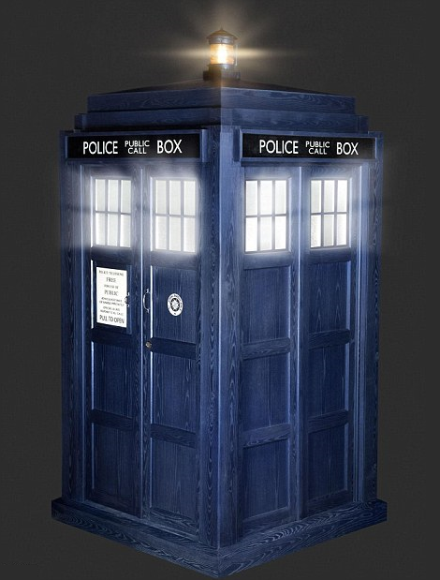

Slide 38
Time travel debugging demo

Slide 39
How Does Time-Travel Work?
We don’t actually “reverse” program execution!
No running backward or inverting effects
Instead record state snapshots & events during first execution
Take snapshots of the entire program state at regular intervals
Log all externally driven (non-deterministic) event data
Then to “Reverse” execution
Restore a past program state
Replay events until desired (previous) statement is hit

Slide 40
Record Example
document.onclick = randomish;
var point = new Point();
…
function randomish() //snapshot
{
point.x = Math.random() * 2;
point.y = point.x;
return point.x;
}
null
{
“point”: {“x”: 5, “y”: 3}
}
“Snapshot”:
“Log”: [
]
{“random”: 0.5}
]
State:
point -> {“x”: , “y”: }
1
1
5
3

Slide 41
Replay Example
document.onclick = randomish;
var point = new Point();
…
function randomish() //snapshot
{
point.x = Math.random() * 2;
point.y = point.x;
return point.x;
}
{
“point”: {“x”: 5, “y”: 3}
}
“Snapshot”:
“Log”: [
{“random”: 0.5}
]
1
5
point -> {“x”: , “y”: 3}
State:
point -> {“x”: 1, “y”: 1}

Slide 42
Time Travel Debugging
A research project at the moment
Hoping to ship as an experimental feature in a future flight

Slide 43

For more checkout the channel 9 talk
(http://channel9.msdn.com/)

Slide 44
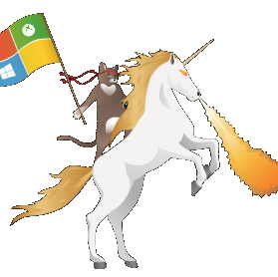
Join in and help build better tools for you
uservoice.modern.ie
connect.microsoft.com
github.com/microsoft
@IEDevTools

Slide 45
?
QUESTIONS
(office hours next)

